Slide 1



YOUAca PREPARATORY WORKS FOR THE ACADEMY SPORT FOR ALL YOUNG LEADERS
The Presentation from Peer Trainers
Participators from last year:
Francesco Molea | Mikk Meerents | Taija Luoma | Alba Galiano

Slide 2
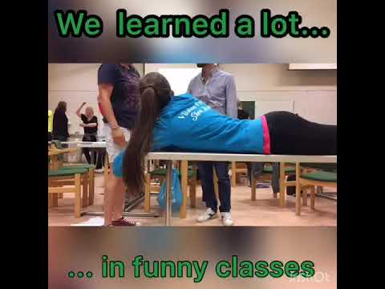
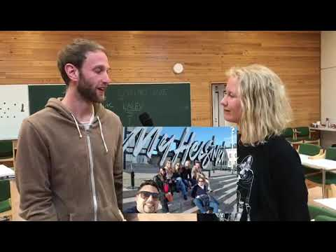
Video(s)
Notes:
I don’t know how to get the video there, there is only that youtube link, sorry… :/

Slide 3
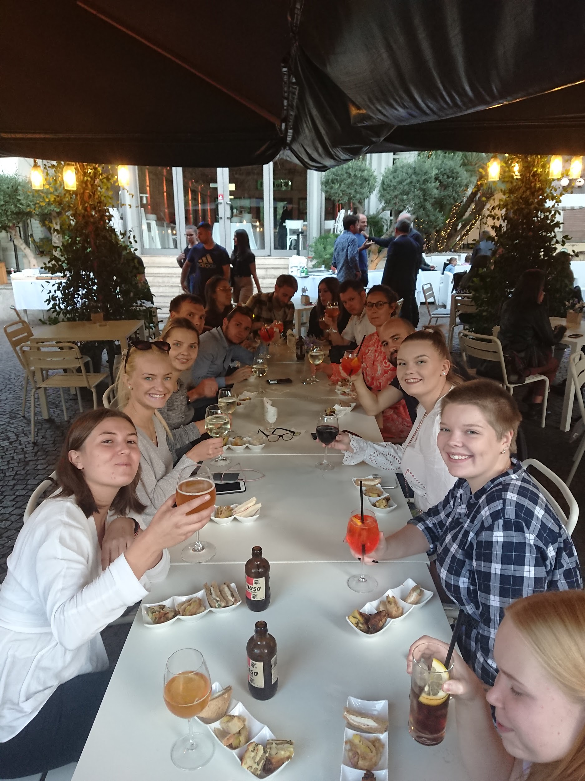
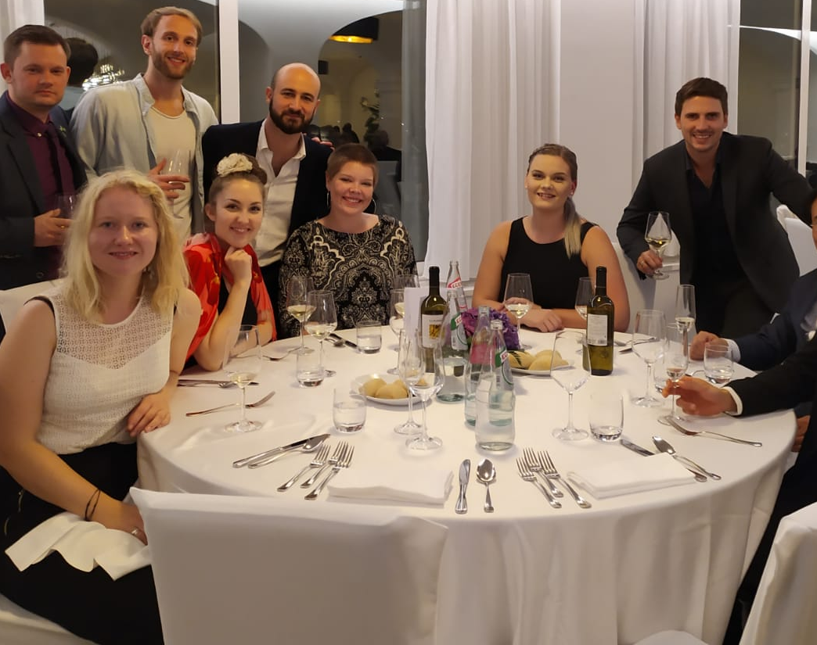
Experience
“The amount of fun we had during dinners, activities and learning was too damn high! Being young leader gave me confidence and that represented on the tasks I carried out on my job.” - Mikk
“The best thing in this project has been this awesome group of young leaders and trainers. I’m happy that I’ve had this opportunity to get to know people who respect similar things and share the same values in grassroot sports. We’ve had so fun days and evenings together in different countries. This project and our experienced trainers have given me fresh perspectives and better management skills to my own voluntary work.” - Taija

Slide 4
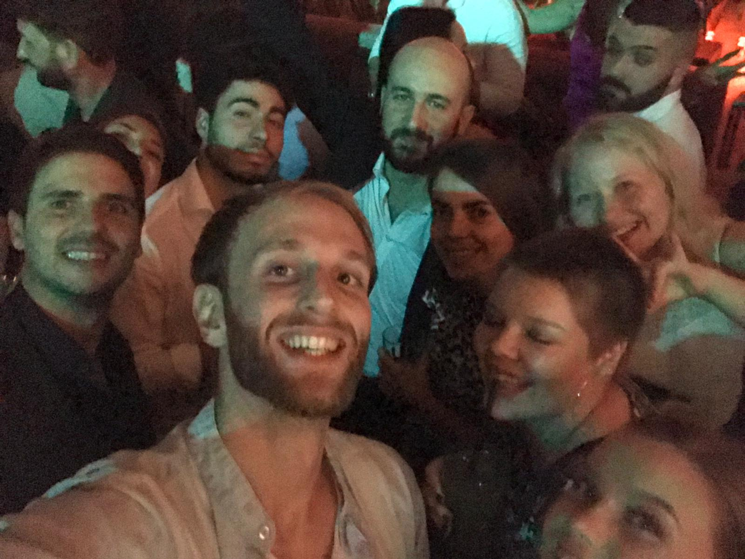
Experience
“Participating in the YouAca Project has been a great experience for me. It is a perfect match between learning and having fun. It gave the opportunity to learn a lot about sport how sport is lived and managed at international level while having a huge amount of fun I didn’t expect I could have in a formative project. Not to mention the fact of making international friendships and the opportunity to travel around Europe learning more about cultures different than mine.” - Francesco
“The experience of participating in this project has been a great surprise. We learned a lot, we had a great time and personally, it helped me have more confidence in myself” - Alba

Slide 5
What we have learned
Skills you need to develop
Communication
Presenting ideas and projects
Overcoming the fear of relating to new people that come from a different country and speak a different language
Teamwork
Leadership
Time management
Create social network and long-term cooperation

Slide 6
We had 3 meetings
Tortosa, Catalonia - March
Kisakeskus, Finland - June
Rome, Italy - October

Slide 7
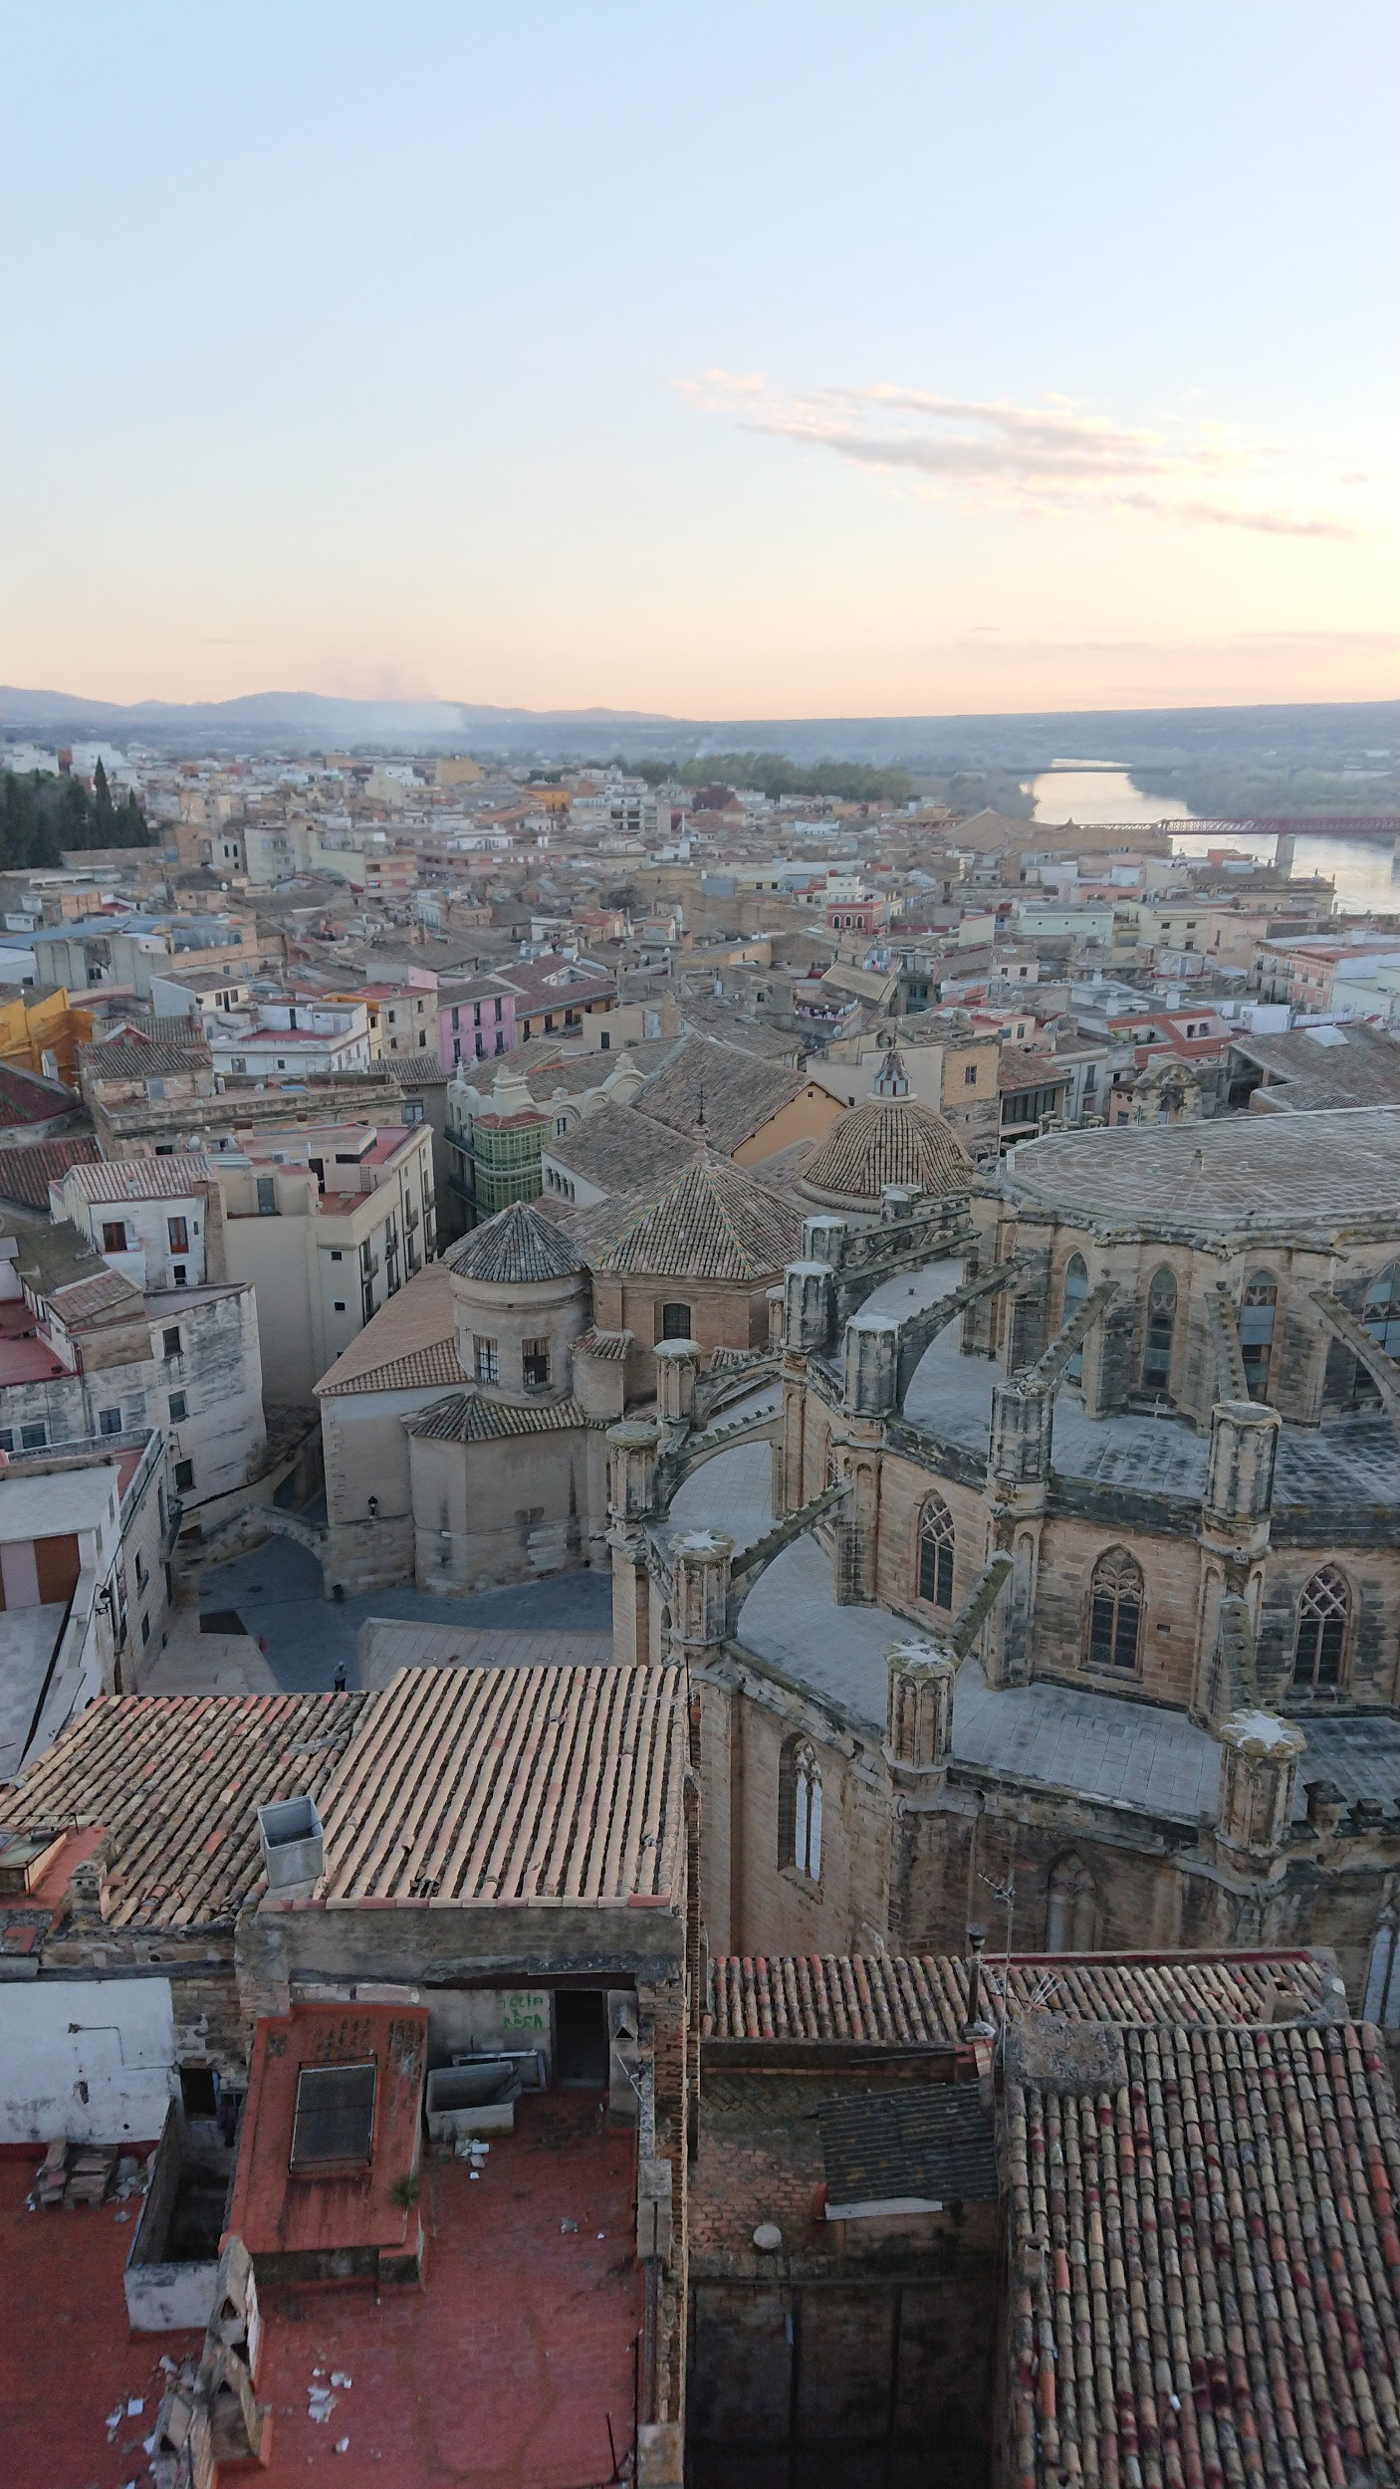
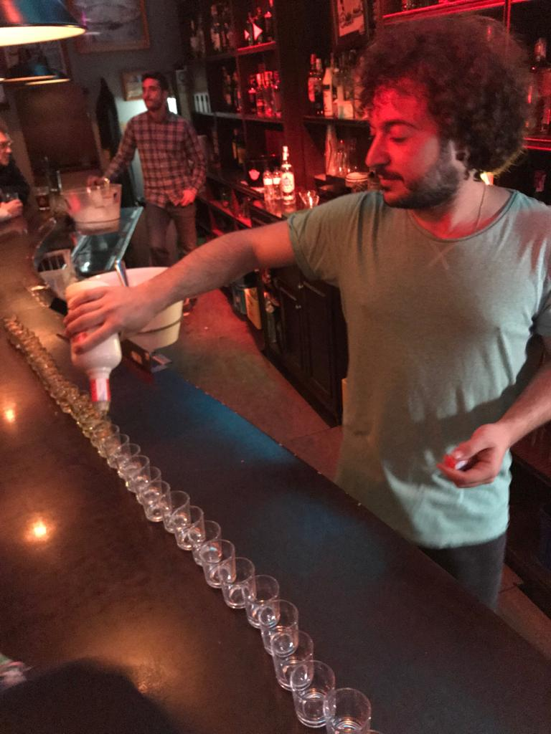
Tortosa - March 2019 (during CSIT executive committee)
What we learned?
understanding better what the possibilities in the grassroots sport are
developing knowledge and skills in administrative, financial and bureaucratic aspects
becoming part of a network at international level
We also met the main executive roles of CSIT, had intergenerational dialogue with them.
On last day we presented the output of the meeting to the audience.
Side activities:
amazing meals
getting to know tapas culture and ”wine tasting”
boat tour in Ebro river
Notes:
This first meeting was two days long, quite intensive weekend. It was held during CSIT executive committee, so we had good chance to get know people from CSIT and discuss with them. Tortosa was really beautiful old town in Catalonia. Tapas and wine <3

Slide 8
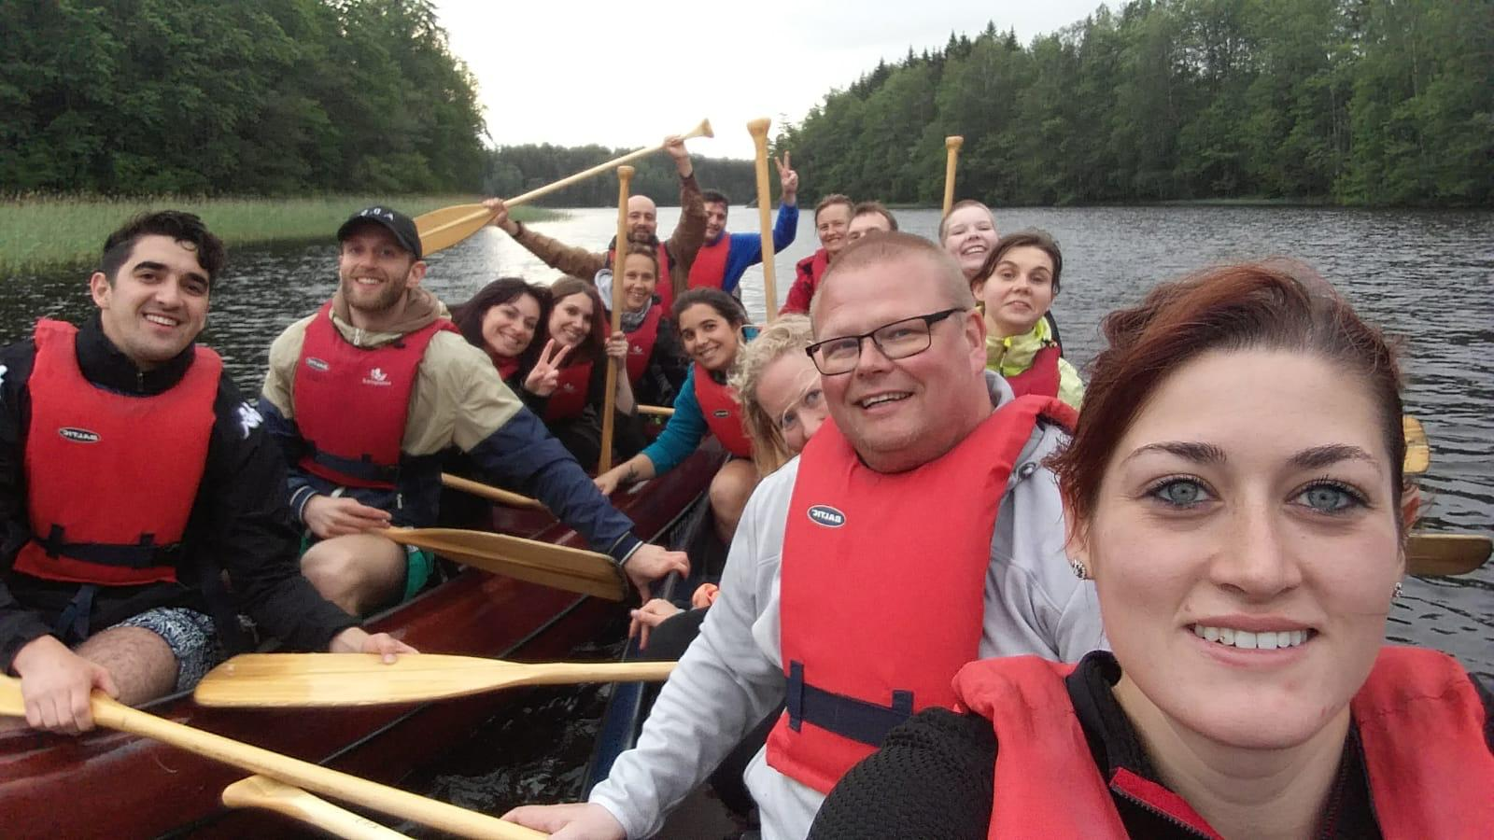
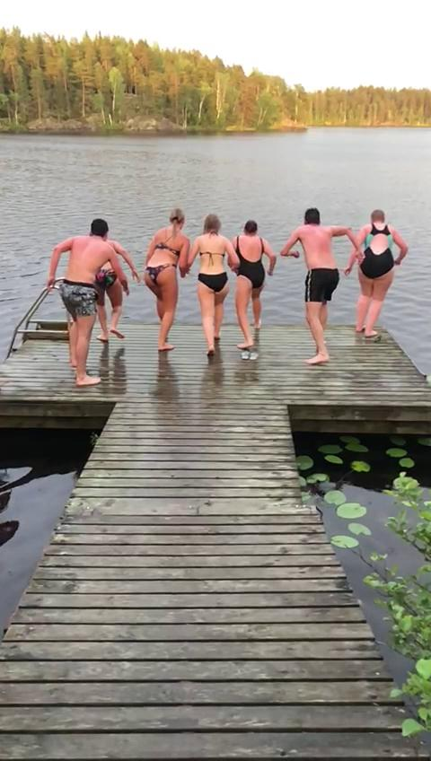
Kisakeskus - June 2019
The Camp was divided into three Modules:
Leading and group
management skills
Grassroots Sport
Event Organization
Networking and
Public communication
Side activities:
Paddling
Smoke sauna and swimming
Orienteering in the woods
Indoor climbing
Archery
Visitation to Fiskars (small village full of artisans, crafts and design)
TUL100 theatre gala
Notes:
Kisakeskus (camp area) located in southern Finland, “middle of nowhere”. Perfect place to enjoy finnish beautiful nature. 5 days long, hosted by TUL.

Slide 9
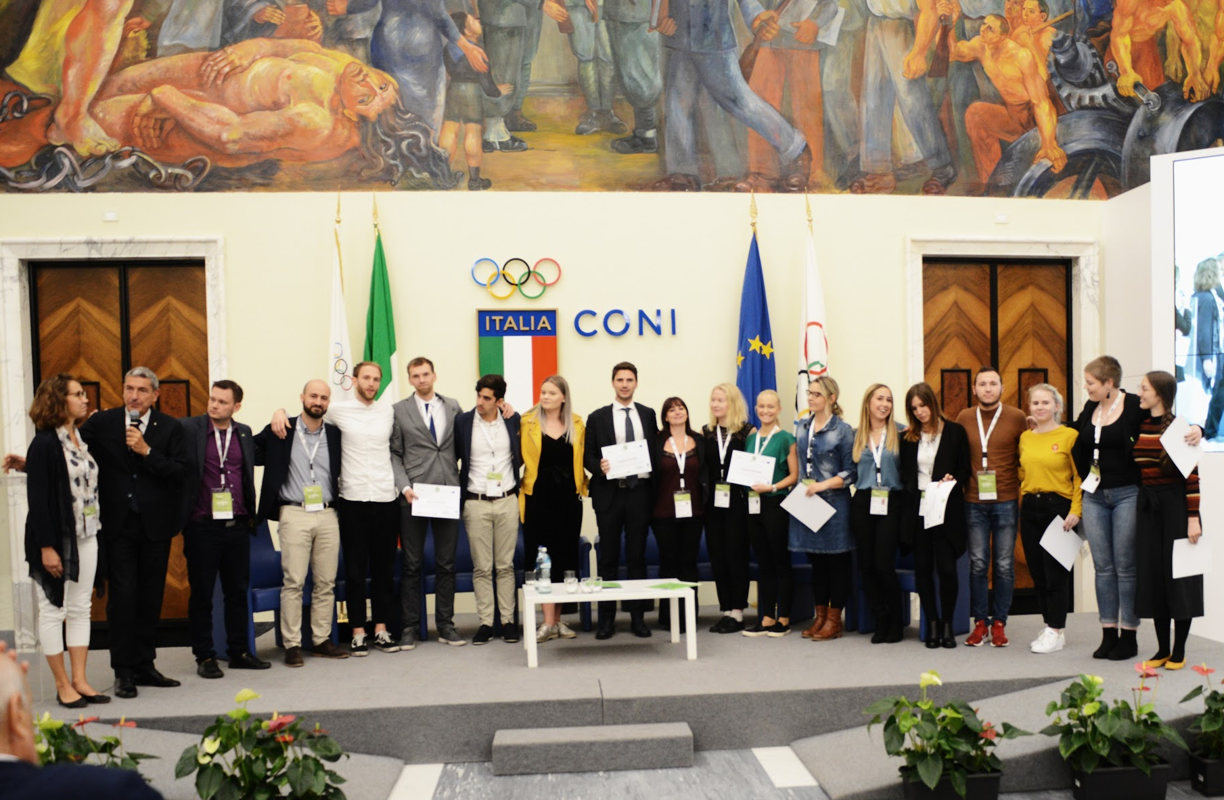
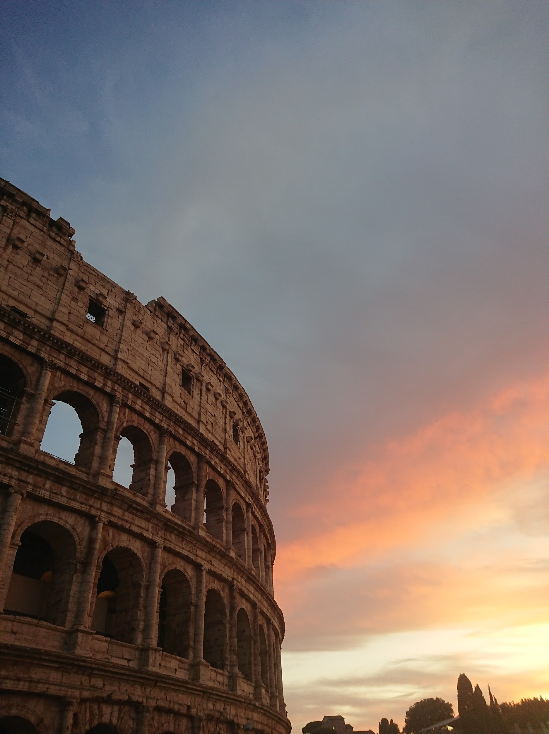
Rome -October 2019 (during CSIT 41st congress)
Presented our organizations project ideas (what we created in Learning by doing -phase). People from CSIT committee evaluated these ideas and gave us some tips.
We had intergenerational dialogue with senior experienced sport leaders (from CSIT and Mamanet)
We participated to the 1° World Amateur Sport Forum, named Sport Impacts All. There we presented all the 4 project ideas to audience
We also...
-Played MAMANET
-Went to sightseeing in Rome
-Had amazing dinners (again)
Notes:
Held in Rome, hosted by AICS, During CSIT 41st Congress. Great opportunity to spend our last meeting together with 130 sport representatives coming from more than 30 countries.
In Amateur sport forum audience was composed by managers, politicians and representatives in the field of grassroots sport, coming from all over the world. It was really great opportunity to show our organizations projects.

Slide 10
4 projects
AICS - National World Sport Games
UCEC - New model for finals competition
TUL - Winter break for TUL network
KALEV - Sports day
Notes:
These projects were our “homeworks”After the Kisakeskus Camp, it was part of the Learning by doing phase. Every group/organization were asked to create a project idea to be proposed to their organisations at national level. We also made videos to promote our project ideas.

Slide 11
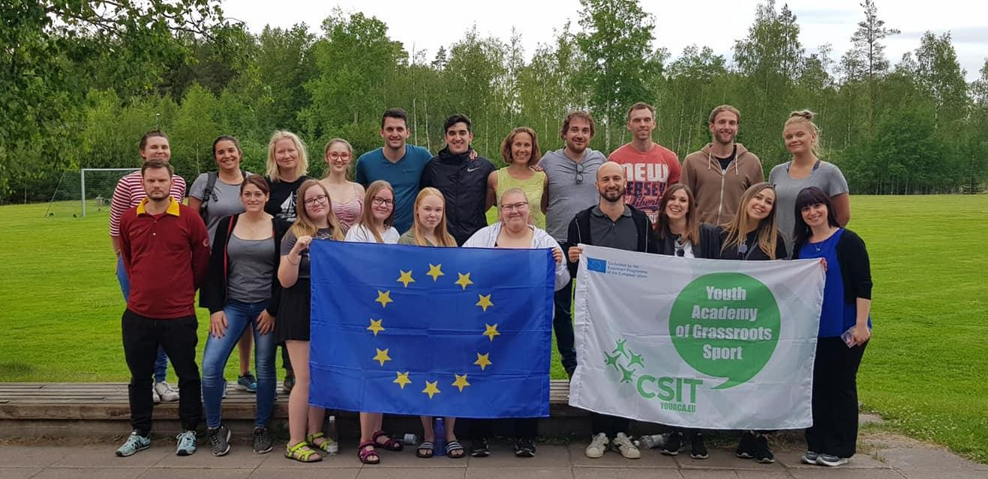
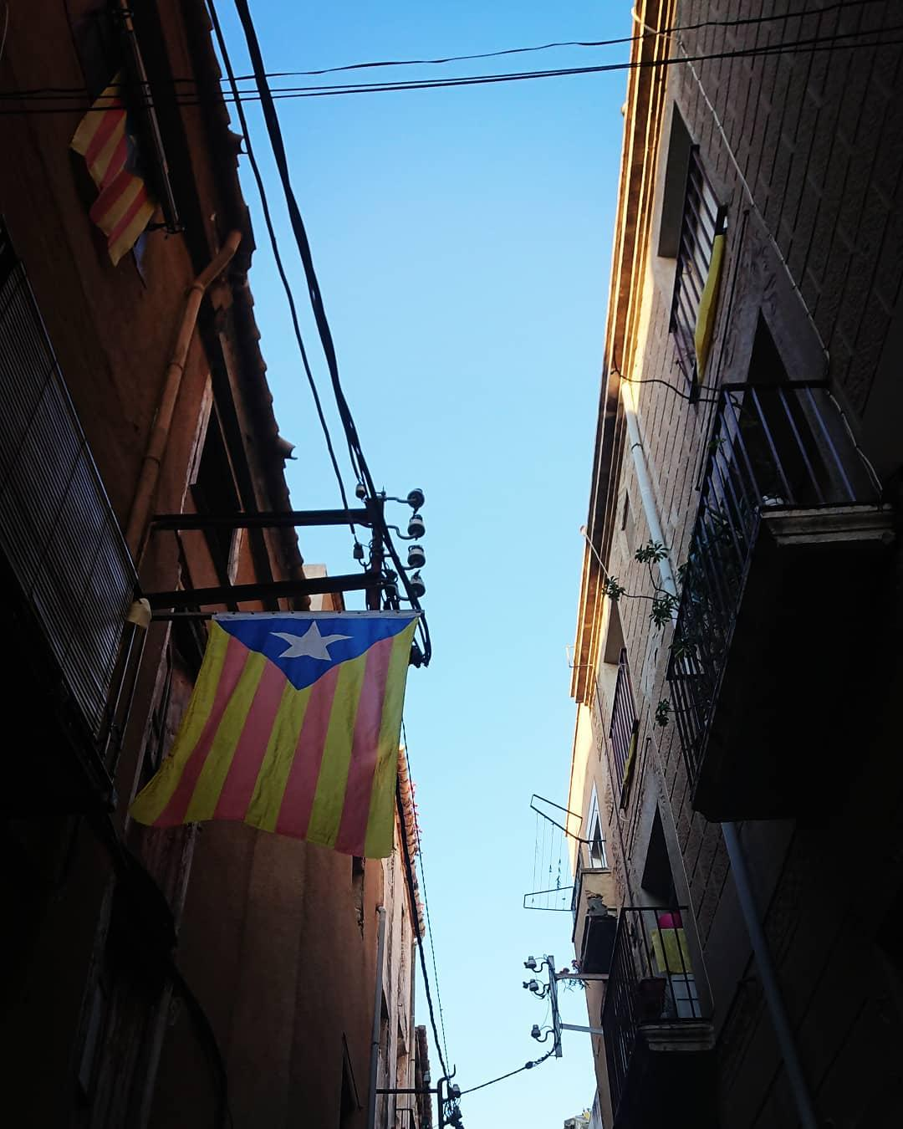
Some pictures
Notes:
Here is some pictures what we can use. I added some pictures to slides also, but you can delete those ones what you don’t need! -Taija

Slide 12
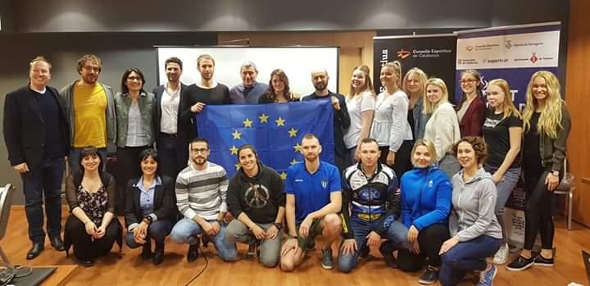
Summary
Together we are stronger!
We (you) can make changes!
We have a lot to learn how to become a better future sports leader!

