Slide 1



ICE BREAKING PRESENTATION
Answer to these questions in approximately 40 sec:
1 Tell us your name, age and where you come from
2 Describe yourself with one word
3 What do you like to do in your free time?

Slide 2

ROLES OF THE PROJECT
Communicate with CSIT, partner organisations and EC
In charge of meetings’ organisation
PROJECT MANAGEMENT
Cosimo Renzi
TRAINERS’ TEAM
Anu Rajajarvi
Riku Ahola
PEER TRAINERS
Francesco Molea
Taija Luoma
Alba Galliano
Mikk Meerents
NATIONAL COORDINATORS
Jarkko Tenkula (TUL)
Roberto Vecchione (AICS)
Joan Guell (UCEC)
Alexsander Tammert (KALEV)
Dario Jagic (HLA)
Coordinating and supporting the young leaders team at national level
Communicate with the project management
In charge of training programme/activities
Coordinate Peer Trainer group
Tutoring of Young Leaders groups
Supporting the trainer team

Slide 3
Title: YOUAca PREPARATORY WORKS FOR THE ACADEMY SPORT FOR ALL YOUNG LEADERS
Co-funded by the Erasmus+ programme
Project lifetime: 1 year (2019)

Slide 4
YOUAca IN NUMBERS
30 YOUNG LEADERS
5 GRASSROOTS SPORT ORGANISATIONS
20 SENIOR MANAGERS FROM CSIT AND THE PARTNER ORGANISATIONS
3 TRANSNATIONAL MEETINGS
1 GUIDELINES
2 NATIONAL AND 1 INTERNATIONAL CONFERENCES
1 INTERNATIONAL CAMP
4 PROJECT IDEAS
1 WEBSITE
4 PROMOTIONAL VIDEOS

Slide 5

Guidelines addressed to trainers, coaches, managers or teachers who are interested in the setting up of a new generation of young leaders in grassroots sport
Providing tools and information through which an educational program can be start up according to YOUAca methodology
Objective of the program is to develop skills and knowledge in grassroots sport field:
Leadership
Management
Communication

Slide 6
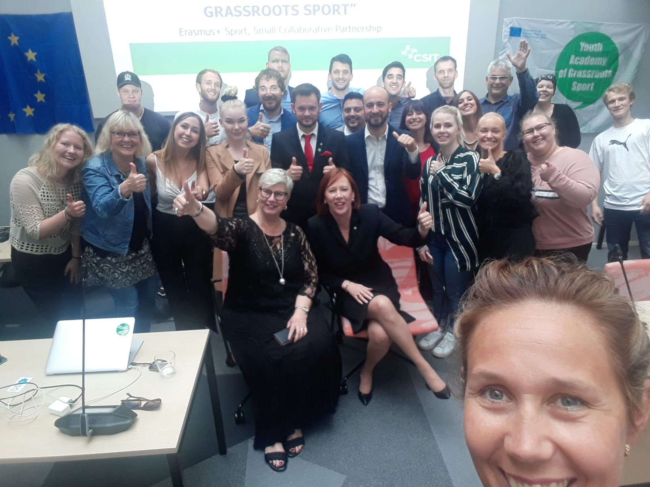





METHODOLOGY
YOUAca is a pilot program of education and mutual learning in which young participants are the actors of the program together with the senior leaders of the partner organisations according to the 2 main pillars of the program:
the Learning by Doing approach and the Intergenerational Dialogue method
WHAT DOES IT MEAN?
Learning from the experiences of CSIT managers through dialogue
Discussing your ideas with CSIT managers and leaders.
Organising events and activities
Working together and projecting new ideas collaborating with your national organisations
Experiencing and practicing grassroots sports

Slide 7
SMALL MIXED GROUPS’ DISCUSSION
Exchange feedback, opinions, comments and doubts about the first edition of the project
and
Discuss about if and how your expectations on the project are changed after the presentations

