Slide 1




“YOUAca 2.0: YOUth Academy of grassroots sport”
Erasmus+ Sport, Small Collaborative Partnership

Slide 2






Title: YOUAca 2.0: YOUth Academy of grassroots sport
Co-funded by the Erasmus+ programme – Small Collaborative Partnership
Project lifetime: from January 2020 to June 2021
Partnership
Coordinator
Partners

Slide 3

WHAT WE ARE / Youth Academy
“YOUAca 2.0 - Youth Academy of Grassroots Sport” is an Eu co-funded project, coordinated by CSIT with a partnership of 6 National sports organizations (AICS/Italy, TUL/ Finland, UCEC/Spain, KALEV/Estonia and HLA/Croatia).
A Pilot program of education and mutual learning
MAIN OBJECTIVE
To deliver the first edition of Youth Academy in grassroots sport, preparing a new generation of young leaders in grassroots sport at national and international level.

Slide 4
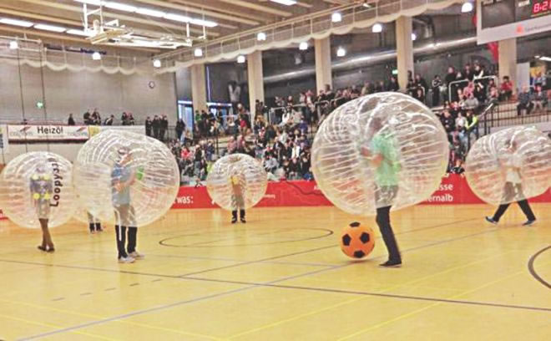


WHAT ARE THE OUTPUTS WE EXPECT TO ACHIEVE?
1. To design new project ideas in 2 CSIT sectors:
Innovative Sports
Sport and Disability
2. To design and test a web platform aimed at promoting connections and ideas between young leaders and sport organisations’ members.
3. To implement the skills learned on the field in collaboration with grassroots sport organisations at national and international level

Slide 5



PROJECT’S ROADMAP
From September to December 2020
3 ONLINE MEETINGS
1st Meeting: To meet each other
2nd Meeting: To get knowledge about innovative sports and disability in sport
3rd Meeting: To define criteria of YOUAca web platform
From December 2020 to March 2021
LEARNING BY DOING AT NATIONAL LEVEL
To design project ideas in collaboration with organisations at national level
March 2021
To present project ideas and get feedback from CSIT managers and leaders
To get skills and knowledge in management and leadership at grassroots sport level
LIVE MEETING IN WIEN

Slide 6

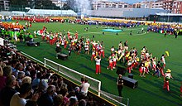
STEPS OF THE PROJECT
From April to May 2021
LEARNING BY DOING
To test the platform at national level.
June 2021
LIVE MEETING IN EMILIA-ROMAGNA
To present the YOUAca platform
To take part to an International grassroots sport event: WSG2021

Slide 7
TASK FOR THE NEXT MEETING
Collect information about your organisation’s activities in the field of innovative sports and disability in sport.
Prepare a brief presentation.

